Slide 1
DISTRIBUTED DATABASE MANAGEMENT SYSTEM (DDBMS)

Slide 2
INTRODUCTION
DDBMS concept
Design strategy
Distributed database environment
DDBMS architecture
Data storing
Transparency

Slide 3
DDBMS CONCEPT
A DDBMS is a centralized software system that manages a distributed database in a manner as if it were all stored in single location.
It is a database in which storage devices are not all attached to a common processor. It may be stored in multiple computers, located in the same physical location or may be dispersed over a network of interconnected computers.
A DDBMS consist of loosely coupled sites that share no physical components.
A distributed database can reside on organized network servers or decentralized independent computers on internet or on extranets.

Slide 4
DDBMS Design strategy
Two processes are responsible for keeping distributed database up to date and current. Such as:
replication
duplication
Replication: Use a specialized software that looks for changes in distributed database. Once the change is identified, the replication process make all the database look same.
It is a complex process & time consuming
Duplication: it identifies one database as master and then duplicates the database.
- it is less complex

Slide 5
Distributed database environment
Types:
1. Homogeneous : they share a common global schema.
-they run identical DBMS software.
-each site is autonomous in terms of right to change the schema or software .
-As same software, no problem in query processing &transaction processing
2. Heterogeneous: different sites have different schema
-they run different DBMS sw.
-each site maintain their own right to change the schema or sw.
-As same software, major problem in query processing &transaction processing.

Slide 6
DDBMS Architecture
Client-server Architecture for DDBMS
Peer-to-Peer Architecture for DDBMS
Multi-DBMS Architecture

Slide 7
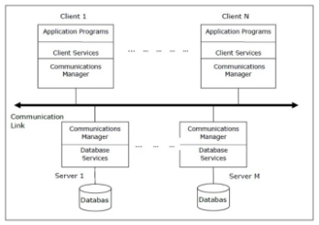
Client-server Architecture for DDBMS

Slide 8
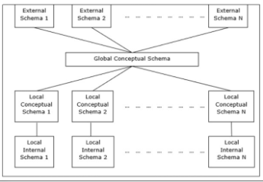
Peer-to-Peer Architecture for DDBMS

Slide 9
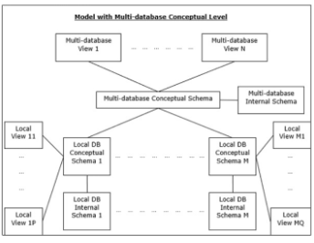
Multi-DBMS Architecture

Slide 10
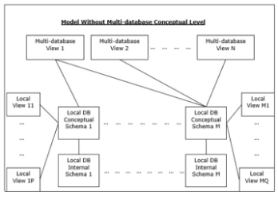
Contd…

Slide 11
Applications of DDBMS
Real time process control:
Aircraft control system
Industrial control system
2. Network Applications:
Massively multiplayer online games and virtual reality community
Network file system
Telecommunication network:
Telephone network and cellular network
Wireless sensor network
Routing algorithm

Slide 12
Data storing
There are 2 principal approaches to store a relation r in database system . i.e.
Replication- Here the system maintain several replicas of the same relation r in different sites.
-Replication can be full or partial.
Fragmentation/partitioning- The relation r is fragmented into several relations r1,r2…..rn in such a way that the actual relation can be reconstructed from fragments and fragments are scattered to different sites.
Horizontal fragmentation- Breaking of R tuple wise.
Vertical fragmentation- Breaking of R schema wise.
Mixed fragmentation- Horizontal fragmentation + Vertical fragmentation

Slide 13
Transparency
It is one property of distributed DBMS by which internal details of the distribution are hidden from users.
Location transparency: users shouldn’t able to know the exact physical location of data.
Fragmentation transparency: users shouldn’t aware about the fragmentation detail.(i.e- horizontal or vertical)
Replication transparency: users shouldn’t aware about the replication details.(i.e- full or partial)
Naming transparency: naming ambiguity shouldnt be there.

Slide 14
Some terminologies related to DDBMS
Local transaction- access and update data only at the site where it is initiated.
Global transaction- access and update data other than the site where it is initiated.
Coordinator site- the site at which the transaction is initiated.
Participating site- there are site where sub transaction are executed.
Transaction manager- Each of the sites is having a TM and the TM of Coordinator site is responsible for managing transaction of participating sites.
Transaction coordinator- Each of the sites is having a TC each and each of them coordinate their own site.

Slide 15
Controlling concurrency
Distributed locking:-
This scheme is implemented by lock managers Single lock manger-the system maintains a lock manager resides on single site & all the request to lock, unlock are sent to that particular site.
Distributed lock manager-
Each site maintain a local lock manager which is responsible for handling lock & unlock request for those data items that are stored in that site.

Slide 16
Controlling concurrency
Distributed 2 phase Locking algorithm
- centralized 2phase locking
-primary copy 2phase locking
- distributed 2 phase locking
-majority locking
Distributed Timestamp concurrency control
- conflict graph
Distributed Optimistic concurrency control algorithm

Slide 17
Distributed locking
Centralized 2phase locking: One site is designated as central lock manager.
Primary copy 2phase locking: A no of sites are designated as central lock manager. All sites knows which lock manager is responsible for managing which data table.
Distributed 2 phase locking: A no of sites are designated as central lock manager. Each lock manager controls locks of data of their local site.
Majority locking- Here majority of copies must be locked in case of read & write request for a data item.

Slide 18
Distributed Timestamp concurrency control
Idea is that each transaction in the system is assigned a unique timestamp to determine the serialization.
-Centralized scheme-Here timestamp is logical counter or clock
-Distributed scheme- local timestamp +site id
1|S1=1S1 1|S2=1S2
1S1 > 1S2
2S1 > 1S2
3S1 > 1S2
then 4S1 counter increased to 4
S1
S2

Slide 19
Distributed Optimistic concurrency control algorithm
It is an extension of Optimistic concurrency control algorithm .hence 2 rules are applied.
Rule 1:A transaction must be validated locally at all sites when it executes. Invalid transaction must be aborted. Local validation guarantees that the transaction maintains serializability.
Rule 2: After local validation test, the transaction is tested globally. Global validation ensures that if conflicting transaction runs together at diff sites, they should commit in the order they run.
-this require a transaction to wait for the other conflicting transaction, after validation before commit

Slide 20
Recovery Techniques
The recovery techniques in distributed database systems are as follows:
-ARIES
-Remote Back Up system

Slide 21
ARIES
ARIES is a state of the art recovery method
Incorporates numerous optimizations to reduce overheads during normal processing and to speed up recovery
The “advanced recovery algorithm” we studied earlier is modeled after ARIES, but greatly simplified by removing optimizations
Unlike the advanced recovery algorithm, ARIES
Uses log sequence number (LSN) to identify log records
Stores LSNs in pages to identify what updates have already been applied to a database page
Physiological redo
Dirty page table to avoid unnecessary redos during recovery
Fuzzy checkpointing that only records information about dirty pages, and does not require dirty pages to be written out at checkpoint time

Slide 22
ARIES concepts
It is based on Physiological redo: The Affected page is physically identified, action within page can be logical
Used to reduce logging overheads
e.g. when a record is deleted and all other records have to be moved to fill hole
Physiological redo can log just the record deletion
Physical redo would require logging of old and new values for much of the page
Requires page to be output to disk atomically
Easy to achieve with hardware RAID, also supported by some disk systems
Incomplete page output can be detected by checksum techniques,
But extra actions are required for recovery
Treated as a media failure

Slide 23
ARIES Data Structures
ARIES uses several data structures
Log sequence number (LSN) identifies each log record
Must be sequentially increasing
Typically an offset from beginning of log file to allow fast access
Easily extended to handle multiple log files
Page LSN
Log records of several different types
Dirty page table

Slide 24
Page LSN
Each page contains a PageLSN which is the LSN of the last log record whose effects are reflected on the page
To update a page:
X-latch the page, and write the log record
Update the page
Record the LSN of the log record in PageLSN
Unlock page
To flush page to disk, must first S-latch page
Thus page state on disk is operation consistent
Required to support physiological redo
PageLSN is used during recovery to prevent repeated redo
Thus ensuring idempotence

Slide 25
Log Record
Each log record contains LSN of previous log record of the same transaction LSN in log record may be implicit
Special redo-only log record called compensation log record (CLR) used to log actions taken during recovery that never need to be undone
Serves the role of operation-abort log records used in advanced recovery algorithm
Has a field UndoNextLSN to note next (earlier) record to be undone
Records in between would have already been undone
Required to avoid repeated undo of already undone actions
LSN TransID PrevLSN RedoInfo UndoInfo
LSN TransID UndoNextLSN RedoInfo
1
2
3
4
4'
3'
2'
1'

Slide 26
Dirty Page Table
Dirty PageTable
List of pages in the buffer that have been updated
Contains, for each such page
PageLSN of the page
RecLSN is an LSN such that log records before this LSN have already been applied to the page version on disk
Set to current end of log when a page is inserted into dirty page table (just before being updated)
Recorded in checkpoints, helps to minimize redo work
Page LSNs
on disk
P1
P6
P23
Page PLSN RLSN
P1 25 17
P6 16 15
P23 19 18
P1 16
…
P6 12
..
P15 9
..
P23 11
25
16
19
P15
9
Buffer Pool
Dirty Page Table

Slide 27
Checkpoint Log
Checkpoint log record contains
Dirty Page Table and list of active transactions
For each active transaction, Last LSN, the LSN of the last log record written by the transaction
Fixed position on disk notes LSN of last completed checkpoint log record
Dirty pages are not written out at checkpoint time
Instead, they are flushed out continuously, in the background
Checkpoint is thus very low overhead
can be done frequently

Slide 28
ARIES Recovery Algorithm
ARIES recovery involves three passes
Analysis pass: Determines
Which transactions to undo
Which pages were dirty (disk version not up to date) at time of crash
Redo LSN: LSN from which redo should start
Redo pass:
Repeats history, redoing all actions from Redo LSN
RecLSN and PageLSNs are used to avoid redoing actions already reflected on page
Undo pass:
Rolls back all incomplete transactions
Transactions whose abort was complete earlier are not undone

Slide 29
3 Passes diagram
Analysis, redo and undo passes
Analysis determines where redo should start
Undo has to go back till start of earliest incomplete transaction
Last checkpoint
End of Log
Time
Log
Analysis pass
Redo pass
Undo pass

Slide 30
Analysis Pass
Analysis pass
Starts from last complete checkpoint log record
Reads DirtyPageTable from log record
Sets RedoLSN = min of RecLSNs of all pages in DirtyPageTable
In case no pages are dirty, RedoLSN = checkpoint record’s LSN
Sets undo-list = list of transactions in checkpoint log record
Reads LSN of last log record for each transaction in undo-list from checkpoint log record
Scans forward from checkpoint

Slide 31
Continued…
Scans forward from checkpoint
If any log record found for transaction not in undo-list, adds transaction to undo-list
Whenever an update log record is found
If page is not in DirtyPageTable, it is added with RecLSN set to LSN of the update log record
If transaction end log record found, delete transaction from undo-list
Keeps track of last log record for each transaction in undo-list
May be needed for later undo
At end of analysis pass:
RedoLSN determines where to start redo pass
RecLSN for each page in DirtyPageTable used to minimize redo work
All transactions in undo-list need to be rolled back

Slide 32
Redo Pass
Redo Pass: Repeats history by replaying every action not already reflected in the page on disk, as follows:
Scans forward from RedoLSN. Whenever an update log record is found:
If the page is not in DirtyPageTable or the LSN of the log record is less than the RecLSN of the page in DirtyPageTable, then skip the log record
Otherwise fetch the page from disk. If the PageLSN of the page fetched from disk is less than the LSN of the log record, redo the log record
NOTE: if either test is negative the effects of the log record have already appeared on the page. First test avoids even fetching the page from disk!

Slide 33
Undo Pass
Undo pass:
Performs backward scan on log undoing all transaction in undo-list
Backward scan optimized by skipping unneeded log records as follows:
Next LSN to be undone for each transaction set to LSN of last log record for transaction found by analysis pass.
At each step pick largest of these LSNs to undo, skip back to it and undo it
After undoing a log record
For ordinary log records, set next LSN to be undone for transaction to PrevLSN noted in the log record
For compensation log records (CLRs) set next LSN to be undo to UndoNextLSN noted in the log record
All intervening records are skipped since they would have been undone already

Slide 34
Undo Actions
When an undo is performed for an update log record
Generate a CLR containing the undo action performed (actions performed during undo are logged physicaly or physiologically).
CLR for record n noted as n’ in figure below
Set UndoNextLSN of the CLR to the PrevLSN value of the update log record
Arrows indicate UndoNextLSN value
ARIES supports partial rollback
Used e.g. to handle deadlocks by rolling back just enough to release reqd. locks
Figure indicates forward actions after partial rollbacks
records 3 and 4 initially, later 5 and 6, then full rollback
1
2
3
4
4'
3'
5
6
6'
5'
1'
2'

Slide 35
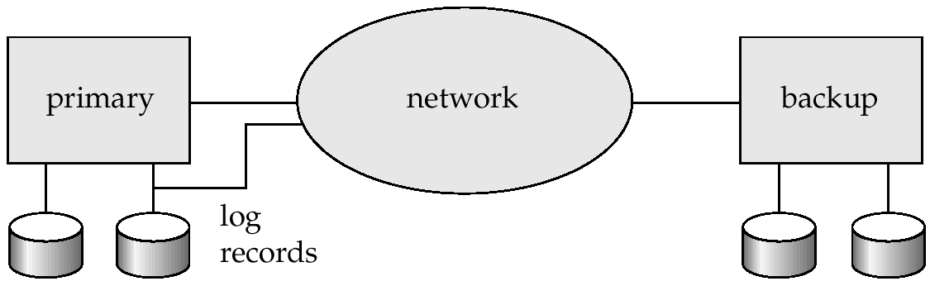
Remote Backup Systems
Remote backup systems provide high availability by allowing transaction processing to continue even if the primary site is destroyed.

Slide 36
Continued…
Detection of failure: Backup site must detect when primary site has failed
to distinguish primary site failure from link failure maintain several communication links between the primary and the remote backup.
Heart-beat messages
Transfer of control:
To take over control backup site first perform recovery using its copy of the database and all the long records it has received from the primary.
Thus, completed transactions are redone and incomplete transactions are rolled back.
When the backup site takes over processing it becomes the new primary
To transfer control back to old primary when it recovers, old primary must receive redo logs from the old backup and apply all updates locally.

Slide 37
Continued...
Time to recover: To reduce delay in takeover, backup site periodically proceses the redo log records (in effect, performing recovery from previous database state), performs a checkpoint, and can then delete earlier parts of the log.
Hot-Spare configuration permits very fast takeover:
Backup continually processes redo log record as they arrive, applying the updates locally.
When failure of the primary is detected the backup rolls back incomplete transactions, and is ready to process new transactions.
Alternative to remote backup: distributed database with replicated data
Remote backup is faster and cheaper, but less tolerant to failure

Slide 38
Continued…
Ensure durability of updates by delaying transaction commit until update is logged at backup; avoid this delay by permitting lower degrees of durability.
One-safe: commit as soon as transaction’s commit log record is written at primary
Problem: updates may not arrive at backup before it takes over.
Two-very-safe: commit when transaction’s commit log record is written at primary and backup
Reduces availability since transactions cannot commit if either site fails.
Two-safe: proceed as in two-very-safe if both primary and backup are active. If only the primary is active, the transaction commits as soon as is commit log record is written at the primary.
Better availability than two-very-safe; avoids problem of lost transactions in one-safe.

